Slide 1
Transport parameters for 0-RTT connections
2nd QUIC and Satellite Open Stakeholder Meeting
2nd December 2021
N. Kuhn (CNES) nicolas.kuhn.ietf@gmail.com
E. Stephan (Orange) emile.stephan@orange.com
G. Fairhurst (University of Aberdeen) gorry@erg.abdn.ac.uk
T. Jones (University of Aberdeen) tom@erg.abdn.ac.uk
C. Huitema (Private Octopus Inc.) huitema@huitema.net

Slide 2
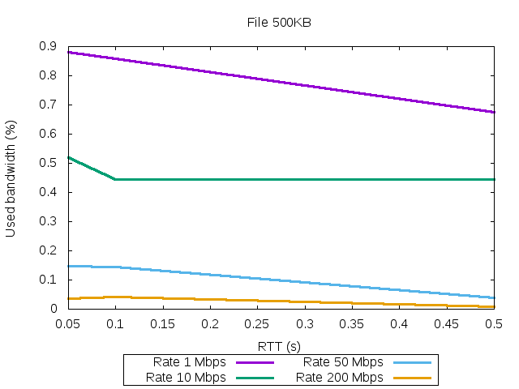
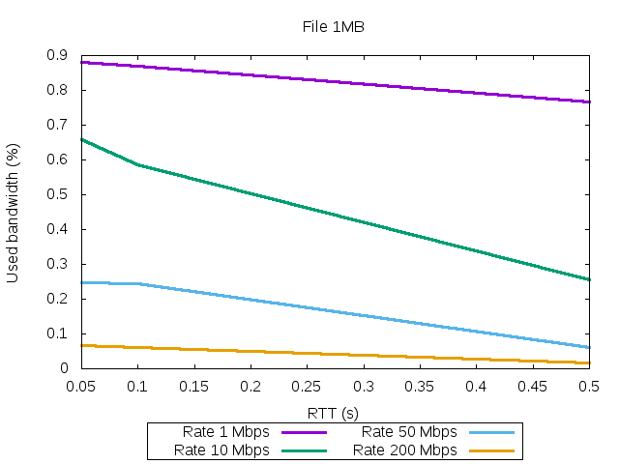
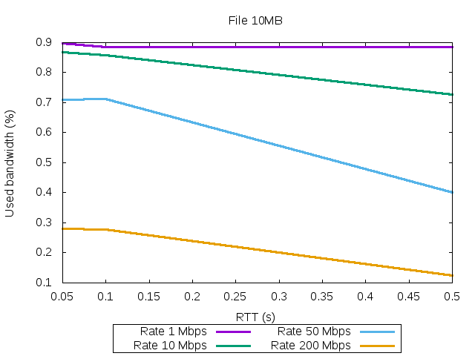
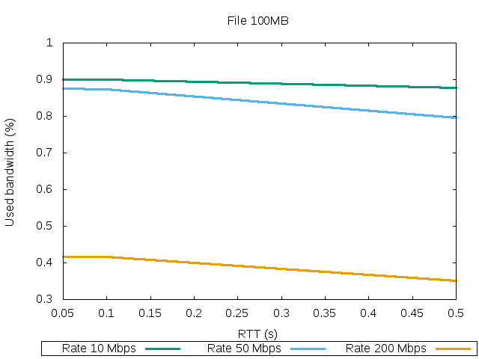
The need for a quick convergence to data-rate
Transport parameters for 0-RTT connections
Tests based on open platform
https://forge.net4sat.org/kuhnn/openbach-example-simple
  PICOQUIC implementation of QUIC
  CC (PICOQUIC with BBR)
Variable RTT (100 ms -> 500 ms)
Size: 500 KB, 1MB, 10 MB, 100MB
Bottleneck (Forward/Return)
    1 Mbps / 100 kbps
    10 Mbps / 2 Mbps
    50 Mbps / 25 Mbps
    200 Mbps / 100 Mbps
A10 MB transfer at1 Mbps, use the bottleneck for all RTT
For shorter transfer (1MB), increasing RTT severely impacts bottleneck utilization
At a high rate (250 Mbps), even a 100 MB transfer does not utilize bottleneck
Increasing the transfer size increases the bottleneck utilization

Slide 3

0-RTT-BDP Extension : Description
Transport parameters for 0-RTT connections
CLIENT
SERVER
1. During a previous session:
    current RTT (current_rtt),
    CWND (current_cwnd) and
    client's current IP (current_client_ip)
  are stored as”
    saved_rtt
    saved_cwnd
    saved_client_ip
2. When a session resumes,
    server allowed to use saved values
QUIC handshake
QUIC
1RTT
Data transfer
BDP Frame (containing CWND, RTT, IP)
SERVER : store CWND, RTT, IP
QUIC handshake
QUIC 0RTT
Data transfer
SERVER : uses previous CWND, RTT, IP
https://datatracker.ietf.org/doc/html/draft-kuhn-quic-0rtt-bdp
Implemented in PICOQUIC by F. Simo, D. Pradas
https://github.com/private-octopus/picoquic/pull/1209

Slide 4
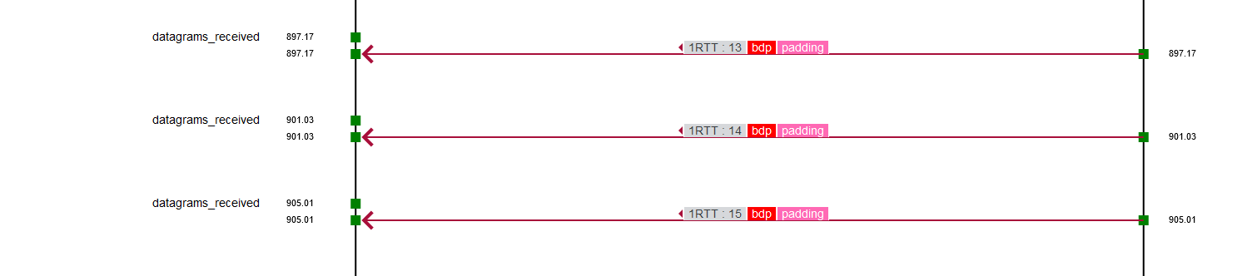
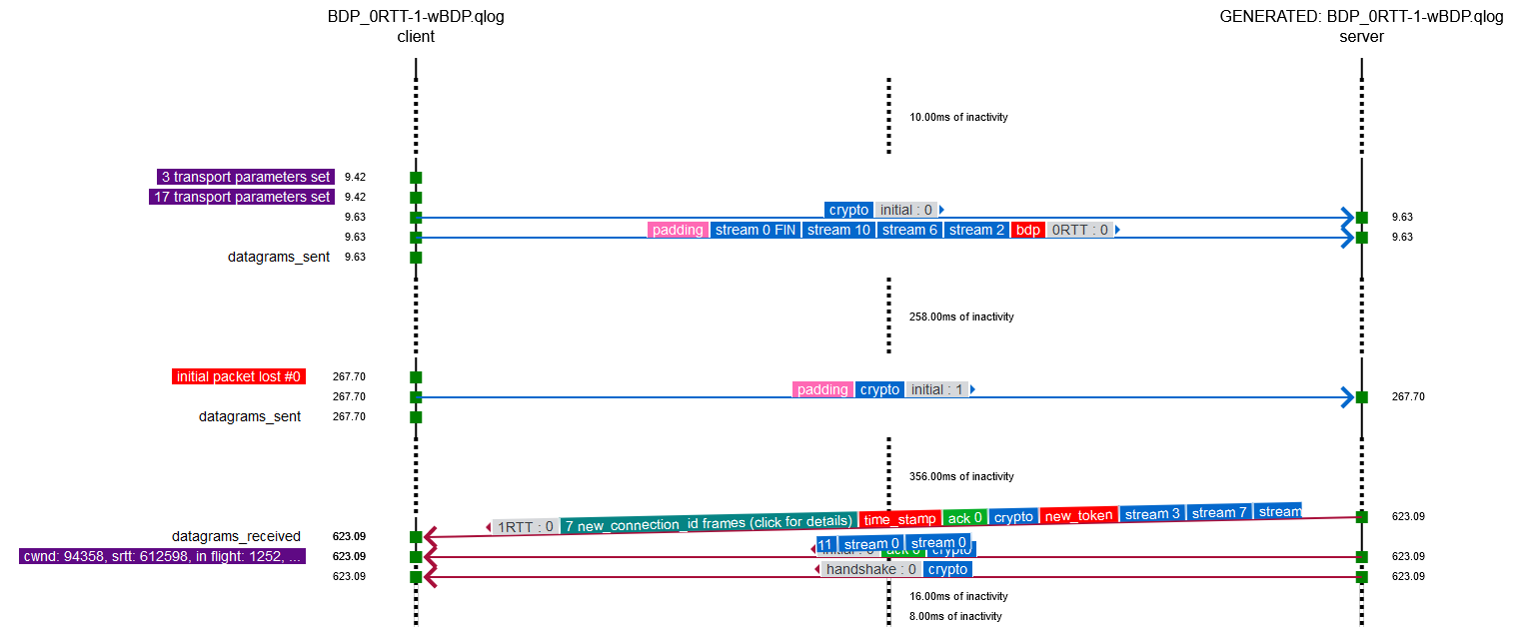
Transport parameters for 0-RTT connections
CLIENT
SERVER
QUIC handshake
Data transfer
QUIC
1RTT
SERVER : stores CWND, RTT, IP
BDP Frame (containing CWND, RTT, IP)
QUIC
0RTT
QUIC handshake
Data transfer
SERVER : uses previous CWND, RTT, IP

Slide 5
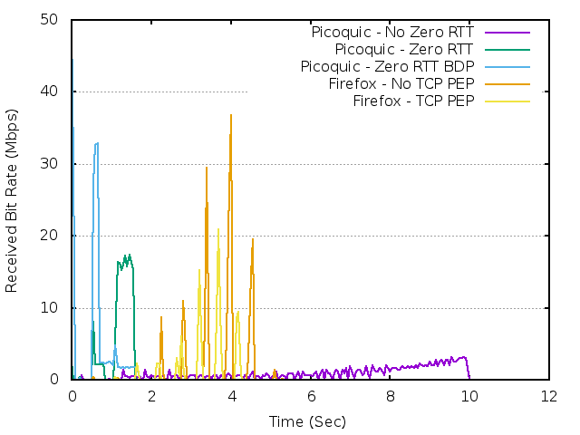
0-RTT-BDP Extension : Emulated Performance
Transport parameters for 0-RTT connections
Evaluation based on:
  draft-kuhn-quic-4-sat-06 scenarios
  Implemented draft-kuhn-quic-0rtt-bdp-07
  Picoquic https://github.com/private-octopus/picoquic/pull/1073
Network characteristics:
  50 Mbps download / 10 Mbps upload
  RTT 650 ms
Congestion control: CUBIC
  0-RTT-BDP reaction:
    jump to measured capacity (not recommended but “easy to implement”)
    Beware the potential issue in using bytes_in_flight metric
Application Transfer: 2 MB - median
Without 0-RTT | With 0-RTT | With 0-RTT-BDP
4,3 s | 3,4 s | 2,9 s
F. Simo, D. Pradas

Slide 6
0-RTT-BDP Extension : Real Satellite Access Performance
Transport parameters for 0-RTT connections
« Internet »
Satellite ISP Network
Satellite Access Network
Local Access Network
PICOQUIC CLIENT
Satellite : GEO - KaSAT
Offer : PRO25
PICOQUIC SERVER
Default and 0-RTT :
commit : 6b917d69bf4ac69d4ab43c42554bb702ed844561
0RTTBDP :
https://github.com/private-octopus/picoquic/pull/1209
Upload 500 kB or 1MB
50 runs

Slide 7
0-RTT-BDP Extension : Real Satellite Access Performance
Transport parameters for 0-RTT connections
 | Without 0-RTT |  | With 0-RTT |  | With 0-RTT-BDP
 | 500 kB | 1 MB | 500 kB | 1 MB | 500 kB | 1 MB
Min transfer time | 3,12 s | 3,87 s | 2,43 s | 3,19 s | 1,87 s | 2,78 s
Ave. transfer time | 11,34 s | 17,15 s | 7,59 s | 10,24 s | 4,24 s | 6,47 s
Max transfer time | 47,82 s | 61,43 s | 33,69 s | 33,92 s | 15,55 s | 23,88 s
CLIENT
SERVER
CLIENT
SERVER
CLIENT
SERVER
QUIC handshake
QUIC
1RTT
QUIC handshake
Data transfer
Data transfer
SERVER : store CWND, RTT, IP
Data transfer
QUIC
1RTT
QUIC
1RTT
BDP Frame (containing CWND, RTT, IP)
SERVER : store CWND, RTT, IP
SERVER : uses previous CWND, RTT, IP
QUIC
0RTT
QUIC handshake
QUIC
0RTT
Data transfer
Data transfer
SERVER : uses previous CWND, RTT, IP

Slide 8
0-RTT-BDP Extension : Real Satellite Access Performance
Transport parameters for 0-RTT connections
 | Without 0-RTT |  | With 0-RTT |  | With 0-RTT-BDP
 | 500 kB | 1 MB | 500 kB | 1 MB | 500 kB | 1 MB
Min transfer time | 3,12 s | 3,87 s | 2,43 s | 3,19 s | 1,87 s | 2,78 s
Average transfer time | 11,34 s | 17,15 s | 7,59 s | 10,24 s | 4,24 s | 6,47 s
Max transfer time | 47,82 s | 61,43 s | 33,69 s | 33,92 s | 15,55 s | 23,88 s
Gain for a full 500kB or 1MB transfer (including HTTP GET)
0-RTT vs 1-RTT
up to 33% gain for 500 kB
gain due to arrival of HTTP request one RTT in advance (and satellite RTT !)
up to 45 % gain for 1 MB
0-RTT-BDP vs 1-RTT
up to 67% gain for 500 kB
up to 62% gain for 1 MB

Slide 9
Questions
Transport parameters for 0-RTT connections
Why were these tests only run in the upload direction ?
    Because traffic was blocked (server ? ISP?) in download direction
Why were the tests not run with a terrestrial access ?
    Because my terrestrial ISP blocked traffic in both directions
Is it safe to deploy the 0RTTBDP draft ?
    We could use this approach without « breaking » the Internet
    QoS mechanisms seem robust, need detailed simulations
  Would you interested in implementing?
    We are looking for other implementers and a future WG document

Slide 10
Questions
Transport parameters for 0-RTT connections
draft-kuhn-quic-0rtt-bdp includes 3 different proposed methods
2 methods are implemented in picoquic
BDP frame - https://github.com/private-octopus/picoquic/pull/1209
local storage of CWND, RTT parameters -
https://github.com/private-octopus/picoquic/pull/1204
Any comments ?
We are available through mail !
    N. Kuhn (CNES) nicolas.kuhn.ietf@gmail.com
    E. Stephan (Orange) emile.stephan@orange.com
    G. Fairhurst (University of Aberdeen) gorry@erg.abdn.ac.uk
    T. Jones (University of Aberdeen) tom@erg.abdn.ac.uk
    C. Huitema (Private Octopus Inc.) huitema@huitema.net

