Slide 1
Performance implications of interoperability
2nd of December 2021
2nd QUIC and Satellite Open Stakeholder Meeting
Nicolas KUHN

Slide 2
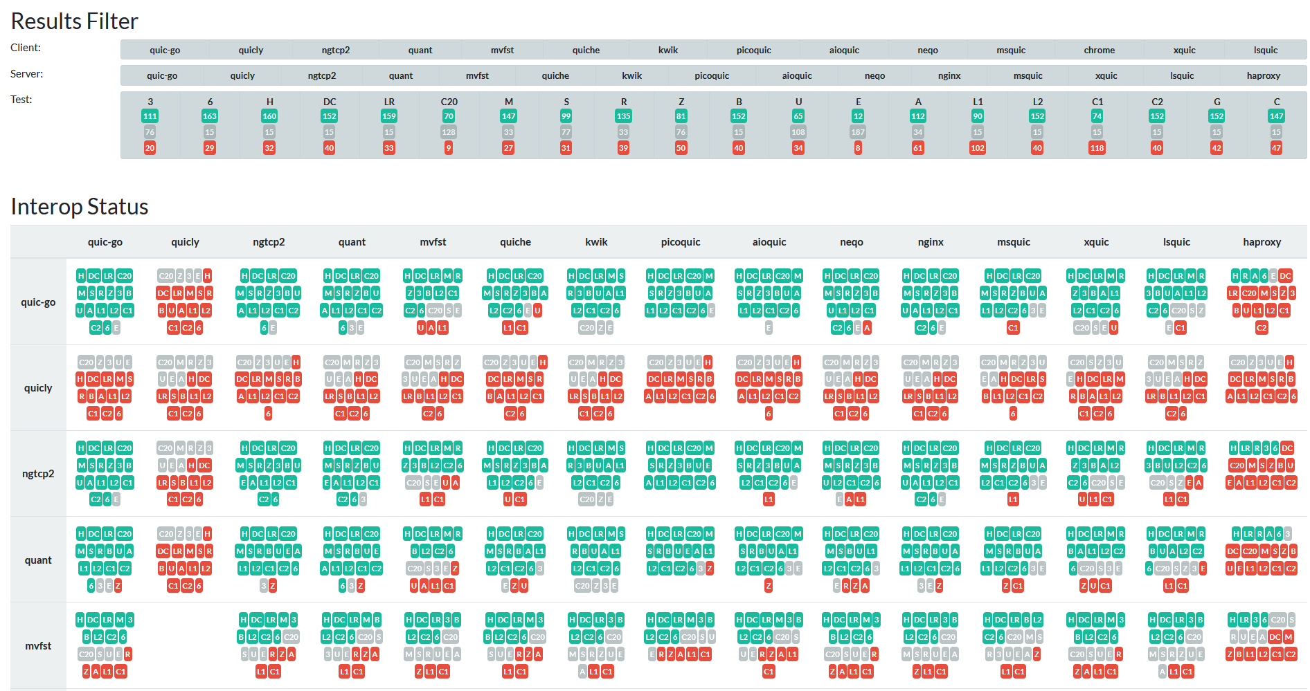
Introduction to interoperability
Performance implications of interoperability
« Interop » matrix
At the core of QUIC WG activity
Help identify issues in the proposed drafts
Interoperability is necessary for a quic client A to communicate with quic server B
https://interop.seemann.io/

Slide 3
When interoperability meets congestion controls
Performance implications of interoperability
QUIC ‘core’
  May not specify much for the congestion control
  Interoperability when it is needed for the life cycle of a connection (establishment, on going, ending)
QUIC extensions can provide interoperability for aspects of the congestion control
  DATAGRAM : unreliable congestion control
  ACK Frequency : tune the ACK ratio and the delay between ACK
  0-RTT-BDP : efficient and careful connection resumption
Interoperability can have an impact on the performance
Client and server both contribute to the performance of a connection

Slide 4
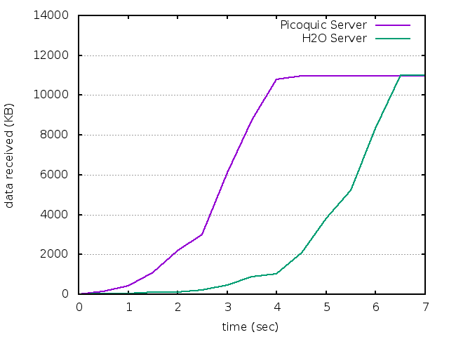
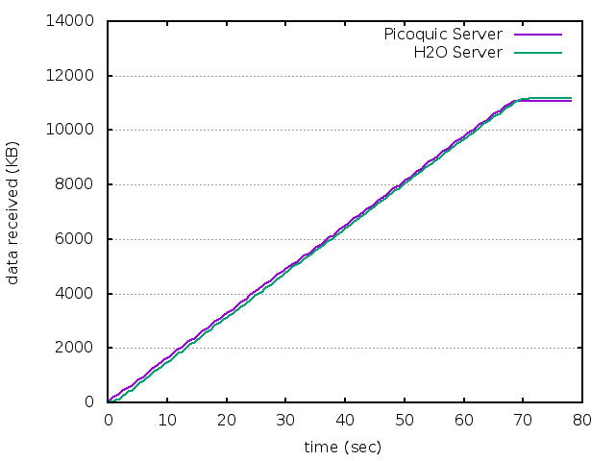
Transport Parameters and QUIC Implementations
Performance implications of interoperability
Default values for congestion controls differ from one implementation to another
The ACK Policy varies:
  PICOQUIC and QUICLY implement « ACK Frequency » (dynamic ACK policy during a connection)
  NGTCP2 follows the RFC9000 (fixed ACK ratio)
ACK poilicy impacts performance
  50 Mbps / 10 Mbps use-case
Transport parameters | picoquic | ngtcp2 | quicly
Intitial_max_data | 1Mo | 1Mo | 16Mo
Initial_max_stream_data_bid_local | 2Mo | 256Ko | 1Mo
Initial_max_stream_data_bid_remote | 64Ko | 256Ko | 1Mo
ICWND | 10 | 10 | 10
Max_udp_payload_size | 1252 | 1252 | 1252
Max_ack_delay | 10ms | 25ms | 25ms
Congestion control | CUBIC, BBR | CUBIC, BBR | CUBIC
PICO-QUIC CLIENT
CURL CLIENT

Slide 5
Take aways
Performance implications of interoperability
Interoperability may be integrated as extensions to QUIC
  These extensions can be negotiated, accepted or rejected
  They may be of interest for a set of clients and servers
Interoperability with congestion control parameters contribute to the performance of a session
  Even if they affect the client!
Questions ?

